Slide 1
Experimental Neutrino Physics III:
Neutrinos as Tools
Diana Parno
Carnegie Mellon University
National Nuclear Physics Summer School, New Haven, CT
25 June 2018

Slide 2
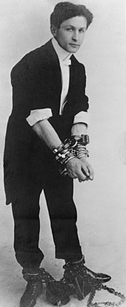
A Reminder: The Weak Force
Neutrinos interact very, very rarely
Hard to detect, but ...
Neutrinos can escape from dense regions
ν
The Houdini of the particle world?
Slide: Kate Scholberg

Slide 3
Outline
Neutrinos for astrophysics
  The Sun
  Supernovae
  Cosmic neutrino background
Neutrinos for geology
Neutrinos for nuclear physics

Slide 4
What’s Inside the Sun?
We’ve seen how solar neutrinos give access to what’s happening in the core
Photons give core information too
Abundance measurements: Spectroscopic measurements of solar photosphere reveal elemental makeup
  Need detailed 3D modeling of temperature, density
Helioseismology: Doppler shifts in spectral reveal oscillations of gas, probing densities in different regions
Recommended review: Alive and well: A short review about standard solar models, Serenelli, EPJA 2016. 52:78

Slide 5
Solar Abundance Problem
In 2001, new 3D radiation hydrodynamic (3D-RHD) models (plus non-equilibrium models for line formation) yielded dramatic revision in heavy element abundances
  30% reduction in metal abundances relative to hydrogen!
Spectroscopic abundance measurements no longer agree with helioseismology
Serenelli, EPJA 52 (2016) 78
Also known as solar metallicity problem: to astronomers “metals” are any elements heavier than helium

Slide 6
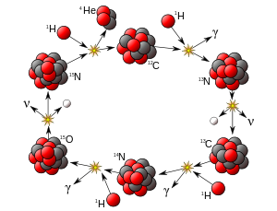
A Need for Neutrinos
CNO cycle responsible for ~1% of Sun’s energy production
If we know the CNO reaction rate, we also know CNO abundances in the core!
Independent systematics from photon-based tools
Solar neutrino fluxes
Image: Wikipedia

Slide 7

Searching for CNO Neutrinos
CNO neutrinos sit under much more numerous pep neutrinos, near ²¹⁰Bi and ¹¹C backgrounds
No discovery yet
⁷Be, ⁸B ν fluxes can’t yet distinguish between SSMs
Cerdeño et al JCAP 04 (2018) 037
Borexino, SNO+, ... could distinguish SSMs in 5-10 years of running – with tight background control
Borexino, arXiv:1707.09279

Slide 8
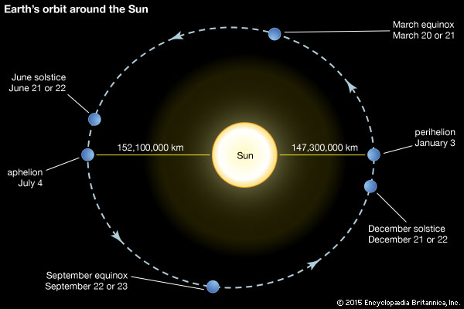
Sidebar: Borexino Precision
Our solar orbit is an ellipse: Earth-Sun distance oscillates!
Observing this effect requires precision and stability over multiple years
ν_{e}-like events in 30.43-day bins
Borexino, Astropart. Phys. 92 (2017) 21

Slide 9
Supernova Neutrinos
A core-collapse supernova loses ~99% of its energy to neutrinos in O (10) s
These neutrinos carry information about:
  Core-collapse physics
  r-process nucleosynthesis
  Neutrino interactions in dense environments
ν_{x} (not ν_{e})
ν_{e}
ν_{e}
Collective effects (ν-ν interactions!)
Recommended review: Supernova Neutrino Detection, Scholberg, Annu. Rev. Nucl. Part. Sci. 62 (2012) 81

Slide 10
Who’s Watching for Supernova νs?
Scholberg, Annu. Rev. Nucl. Part. Sci. 62 (2012) 81
Event estimates assume a supernova at 10 kpc

Slide 11
Very Early Warning System?
When a very massive star starts carbon fusion, neutrino cooling becomes dominant
  Cycles of carbon fusion and core contraction
  Partial decoupling of core and envelope evolution
  Very fast: 1000 years from C fusion onset to Fe core
...
*
*17-25 M_{solar}
197 ± 45 pc away
Pre-collapse
Logarithmic time
Model: Odrzywolek & Heger 2010
Post-collapse
Linear time
Model: Nakazato
et al. 2013
KamLAND, ApJ 818 (2016) 91
Notes:
Not just neutrinos from nuclear reactions! Also unusual branches of pair annihilation, Compton scattering, and bremsstrahlung

Slide 12
Diffuse Supernova Background
Are supernova dynamics the same in older and younger populations of stars?
Are supernova rates constant as the universe evolves?
Figure: Basudeb Dasgupta, Neutrino 2018
We will never observe neutrino bursts from faraway supernovae – but we can extract averaged energy spectra
Next-generation neutrino-oscillation experiments (DUNE, Hyper-K, JUNO) should see this

Slide 13
Cosmic Neutrino Background
a.k.a. relic neutrinos, CνB
Slide: Dan Dwyer

Slide 14
Why Try to Measure the CνB?
Test of physics at very early times / hot temperatures
  CMB: t = 380,000 yrs after Big Bang
  Big Bang nucleosynthesis: t = 1-20 minutes
  CνB: t = 1 s
Confirm crucial input to structure formation models
Fabulous experimental challenge

Slide 15
Indirect Observation
CMB measurements probe plasma acoustic waves
Gravitational influence of free-streaming νs gives phase shift
Rule out null effect (N_{ν} = 0) at 4.5σ
Fix well-known independent parameters
Fix damping scale based on measured He ratios
Normalize oscillation amplitude
Follin et al., PRL 115 (2015) 091301, using Planck 2013 data

Slide 16
How to Measure the CνB
Today, these neutrinos have tiny kinetic energy ~0.5 meV
Conventional neutrino detectors will never see them!
One idea: Capture on β-decaying nuclei
Signature: Monoenergetic peak 2 neutrino masses above observed endpoint
Requires: lots of ³H, excellent energy resolution
ν_{e} + ³H → ³He + β
Rate (evts/eV/yr)
Q_{β}+m_{ν}
Q_{β}
β kinetic energy (eV)
Maybe you’ll have a better idea!
Lazauskas, Vogel, Volpe, J. Phys. G 35 (2008) 025001

Slide 17
Outline
Neutrinos for astrophysics
Neutrinos for geology
Neutrinos for nuclear physics

Slide 18
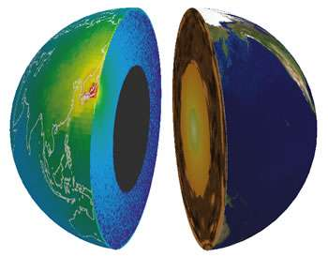
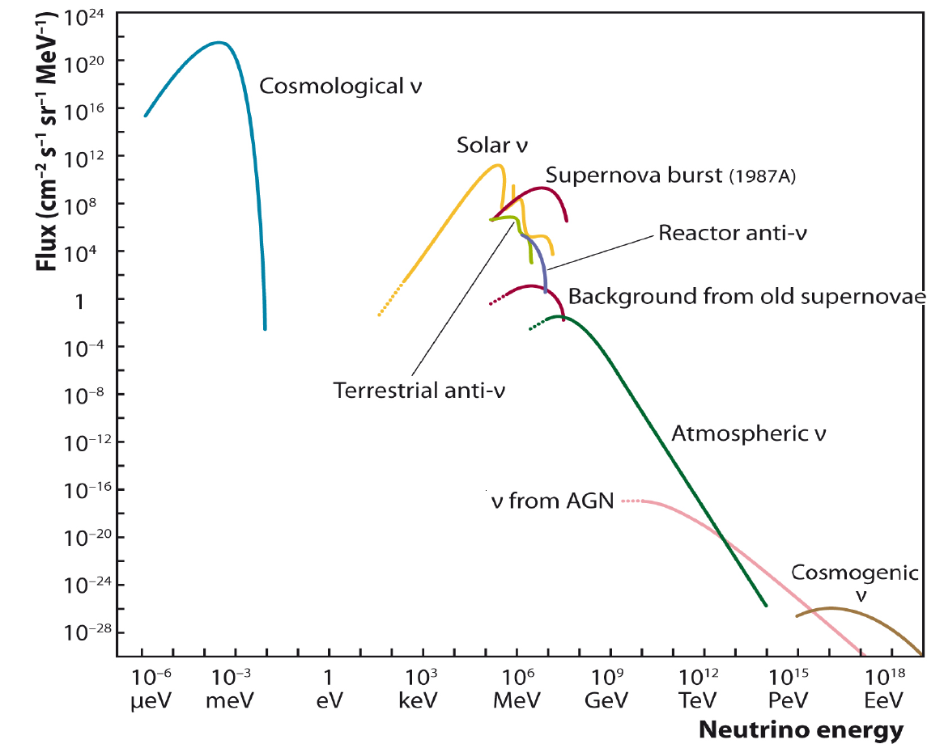
Neutrinos Beneath Our Feet
The Earth produces about ~44 TW of geothermal energy. Where does it come from?
  Residual heat from planetary formation
  Radioactive decays deep within the Earth
Reactor
antineutrinos
Geoneutrinos
Image: Nature

Slide 19
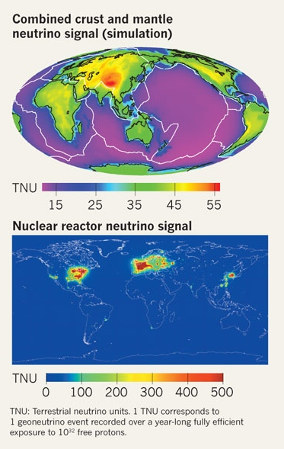
Detecting Geoneutrinos
Large detector
Low energy threshold
Low backgrounds
Separate geoneutrinos from reactor neutrinos
Separate crustal neutrinos from mantle neutrinos
  Need local geological models for crust/mantle boundary
  Someday: an ocean-based geoneutrino detector?
Images: Ondrej Šrámek, Barbara Ricci via Nature

Slide 20

First Discovery
KamLAND (now host of KamLAND-Zen 0νββ experiment) in Japan
Data
Prediction w/o geoneutrinos
Reactor neutrinos
Background
²³⁸U geoneutrinos
²³²Th geoneutrinos
KamLAND, Nature 436 (2005) 499

Slide 21
Early Heat Models!
More data from both KamLAND and Borexino are beginning to constrain geological models
KamLAND* finds ~25-65% of Earth’s heat due to radioactive decays
Borexino finds ~50-80% of Earth’s heat due to radioactive decays
It looks likely that Earth still retains primordial heat
KamLAND, Nat. Geoscience 4 (2011) 647
Borexino, PRD 92 (2015) 031101(R)
Recommended review of physics: Geo-neutrinos, Bellini et al., Prog. Part. Nucl. Phys. 73 (2013) 1 (doesn’t include most recent data)

Slide 22
Outline
Neutrinos for astrophysics
Neutrinos for geology
Neutrinos for nuclear physics
  Reactor antineutrino spectra
  Nonproliferation

Slide 23
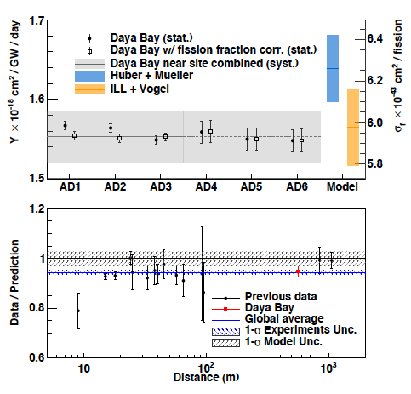
Reactor Antineutrino Deficit
A few years ago, reactor antineutrino flux predictions were updated ...
???
Sterile neutrinos?
Plot: Anna Hayes, Neutrino 2018
Change reflects:
  New data indicating more ν_{e} from ²³⁸U
  Predicted E_{ν} increase for ²³⁵U, ²³⁹Pu, ²⁴¹Pu
Daya Bay, PRL 116 (2016) 061801
RENO, DoubleChooz confirm

Slide 24
Predicting a Reactor ν Spectrum
Reactor thermal energy
Relative fraction of fissions due to each isotope
Cumulative antineutrino spectrum (per fission)
Thermal energy per fission
Ab initio summation method
  List all β-decay branches of all fission fragments
  Sum up contributions to ν spectrum
  Need comprehensive, correct databases!
Conversion method
  Take measured β spectra from fission reactions (at ILL reactor in 1980s)
  Infer ν spectrum corresponding to each β spectrum
βs per fission per MeV
Schreckenbach et al, PLB 160 (1985) 325
E_{β} (MeV)

Slide 25
Back to Nuclear Physics
Sterile neutrinos shouldn’t prefer one β-decaying isotope over another (as long as both are above threshold)
Fission isotope fractions in reactor cores evolve over time
  ²³⁹Pu fraction rises during operation; ²³⁵U fraction falls
Something looks wrong with the predicted antineutrino flux for ²³⁵U
But ... it could be an error in model fit assumptions
Daya Bay results don’t rule out steriles (but do reduce significance of deficit)
Stay tuned for results from research reactors
Daya Bay, PRL 118 (2017) 251801
IBD yield for ²³⁹Pu
IBD yield for ²³⁵U

Slide 26
The 5-MeV “Bump”
All precision reactor neutrino experiments show a ~10% excess over spectral predictions at 4-6 MeV
Plot: Anna Hayes, Neutrino 2018

Slide 27
Sidebar: The Precision ν Era
“Bump” evokes clear, bright resonances
This bump appears on a steeply falling distribution – and it looks rather different
Two Lessons
Modern ν oscillation experiments are making discoveries requiring unprecedented statistics and precision!
Always look at the residuals
RENO, PRL 116 (2016) 211801

Slide 28
The Bump, Revisited
Ab initio flux calculation (2015), using ENDF/B-VII.1 library, shows bump!
Dwyer and Langford, PRL 114 (2015) 012502
But ... no bump when you use alternative JEFF-3.1 library
This inspired a closer look at ENDF in 2016 ...
(Ge)
⁸⁶Ge
Original ENDF/B
⁸⁷Ge
Corrected ENDF/B
⁸⁸Ge
Sonzogni et al, PRL 116 (2016) 132502
JEFF
Notes:
Error probably arose from mis-assignment of Se-86 data to Ge-86 in early 1990s!

Slide 29
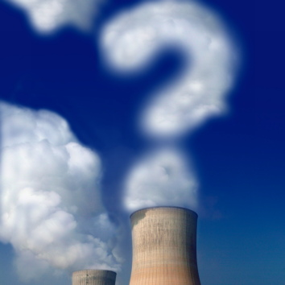
What Does All This Mean?
Measurements of reactor ν_{e} spectra revealed significant discrepancies with model
This could signal exciting new neutrino physics (steriles!)
But it has also already revealed serious deficiencies with available nuclear data
  (Maybe not surprising in catalogs compiled over decades...)
Neutrino results are improving our understanding of nuclear fission
Recommended review: Reactor Neutrino Spectra, Hayes and Vogel, Annu. Rev. Nucl. Part. Sci. 2016. 66:219–44

Slide 30
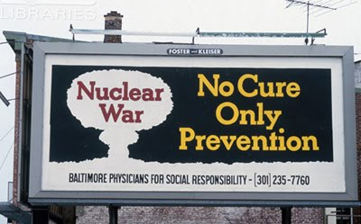
Nuclear Nonproliferation
Nuclear reactors have many uses
  Neutrino sources for physics experiments
  Clean electricity for individuals, industry, hospitals, ...
  Making ²³⁹Pu for nuclear bombs
The world wants to know about:
  Secret reactors?
  Plutonium production at supposedly innocent reactors?
Inspections require substantial cooperation

Slide 31
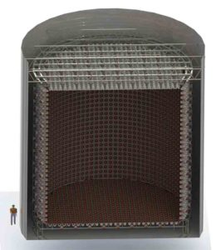
Neutrino Reactor Monitoring
Neutrinos are the perfect informers
  They come right from the core
  Rates reveal on/off cycles (the β emitters are short-lived)
  No power in the ‘verse can stop them
Early work on WATCHMAN
  kton water-Cerenkov detector with Gd doping (detect inverse β decay)
  Monitor reactors within ~50 km
For long-distance monitoring:
  Larger water-Cerenkov detectors?
  Small CEvNS detectors?
Ideal case: A detector network for reactor-neutrino tomography
WATCHMAN conceptual design

Slide 32
To Summarize
We’ve already heard how neutrinos are helping us revise and improve the Standard Model
  See Friday’s lectures; Michael Ramsey Musolf’s lectures; Michelle Dolinski’s seminar
Neutrinos are also potent tools for answering questions from other areas of physics
  Astronomy and cosmology
  Geology
  Nuclear physics and nonproliferation
I’ve left out lots of other neat ideas, from elucidating cosmic-ray sources to measuring nuclear structure
Maybe you’ll add a new idea to this set!
Thank you for the great questions and discussions!

